Slide 1
ELIXIR Beacons and bioschemas
Audald Lloret-Villas (EGA-CRG)
audald.lloret@crg.eu
Bioschemas - Genome Campus – 06.03.2017

Slide 2
Beacon project
A Beacon is a discovery service for genetic variants
Developing tools to make data discoverable
Aiding data sharing
Increasing efficiency in data access process
https://beacon-network.org www.elixir-europe.org/beacons
Led by:
Serena Scollen
Head of Human Genomics and Translational Data, ELIXIR
Marc Fiume
Co-founder and CEO DNAstack

Slide 3


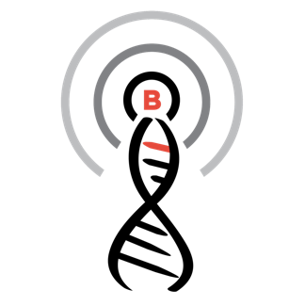
Public data discovery web-service
Do you have information about the allele “C at position 32,936,732 on chromosome 13?”
Do you have information about the allele “C at position 32,936,732 on chromosome 13?”
Yes / No
(+optional metadata about the allele)
Beacon X: Yes
Beacon Y: No
Beacon Z: No
…
https://beacon-network.org

Slide 4

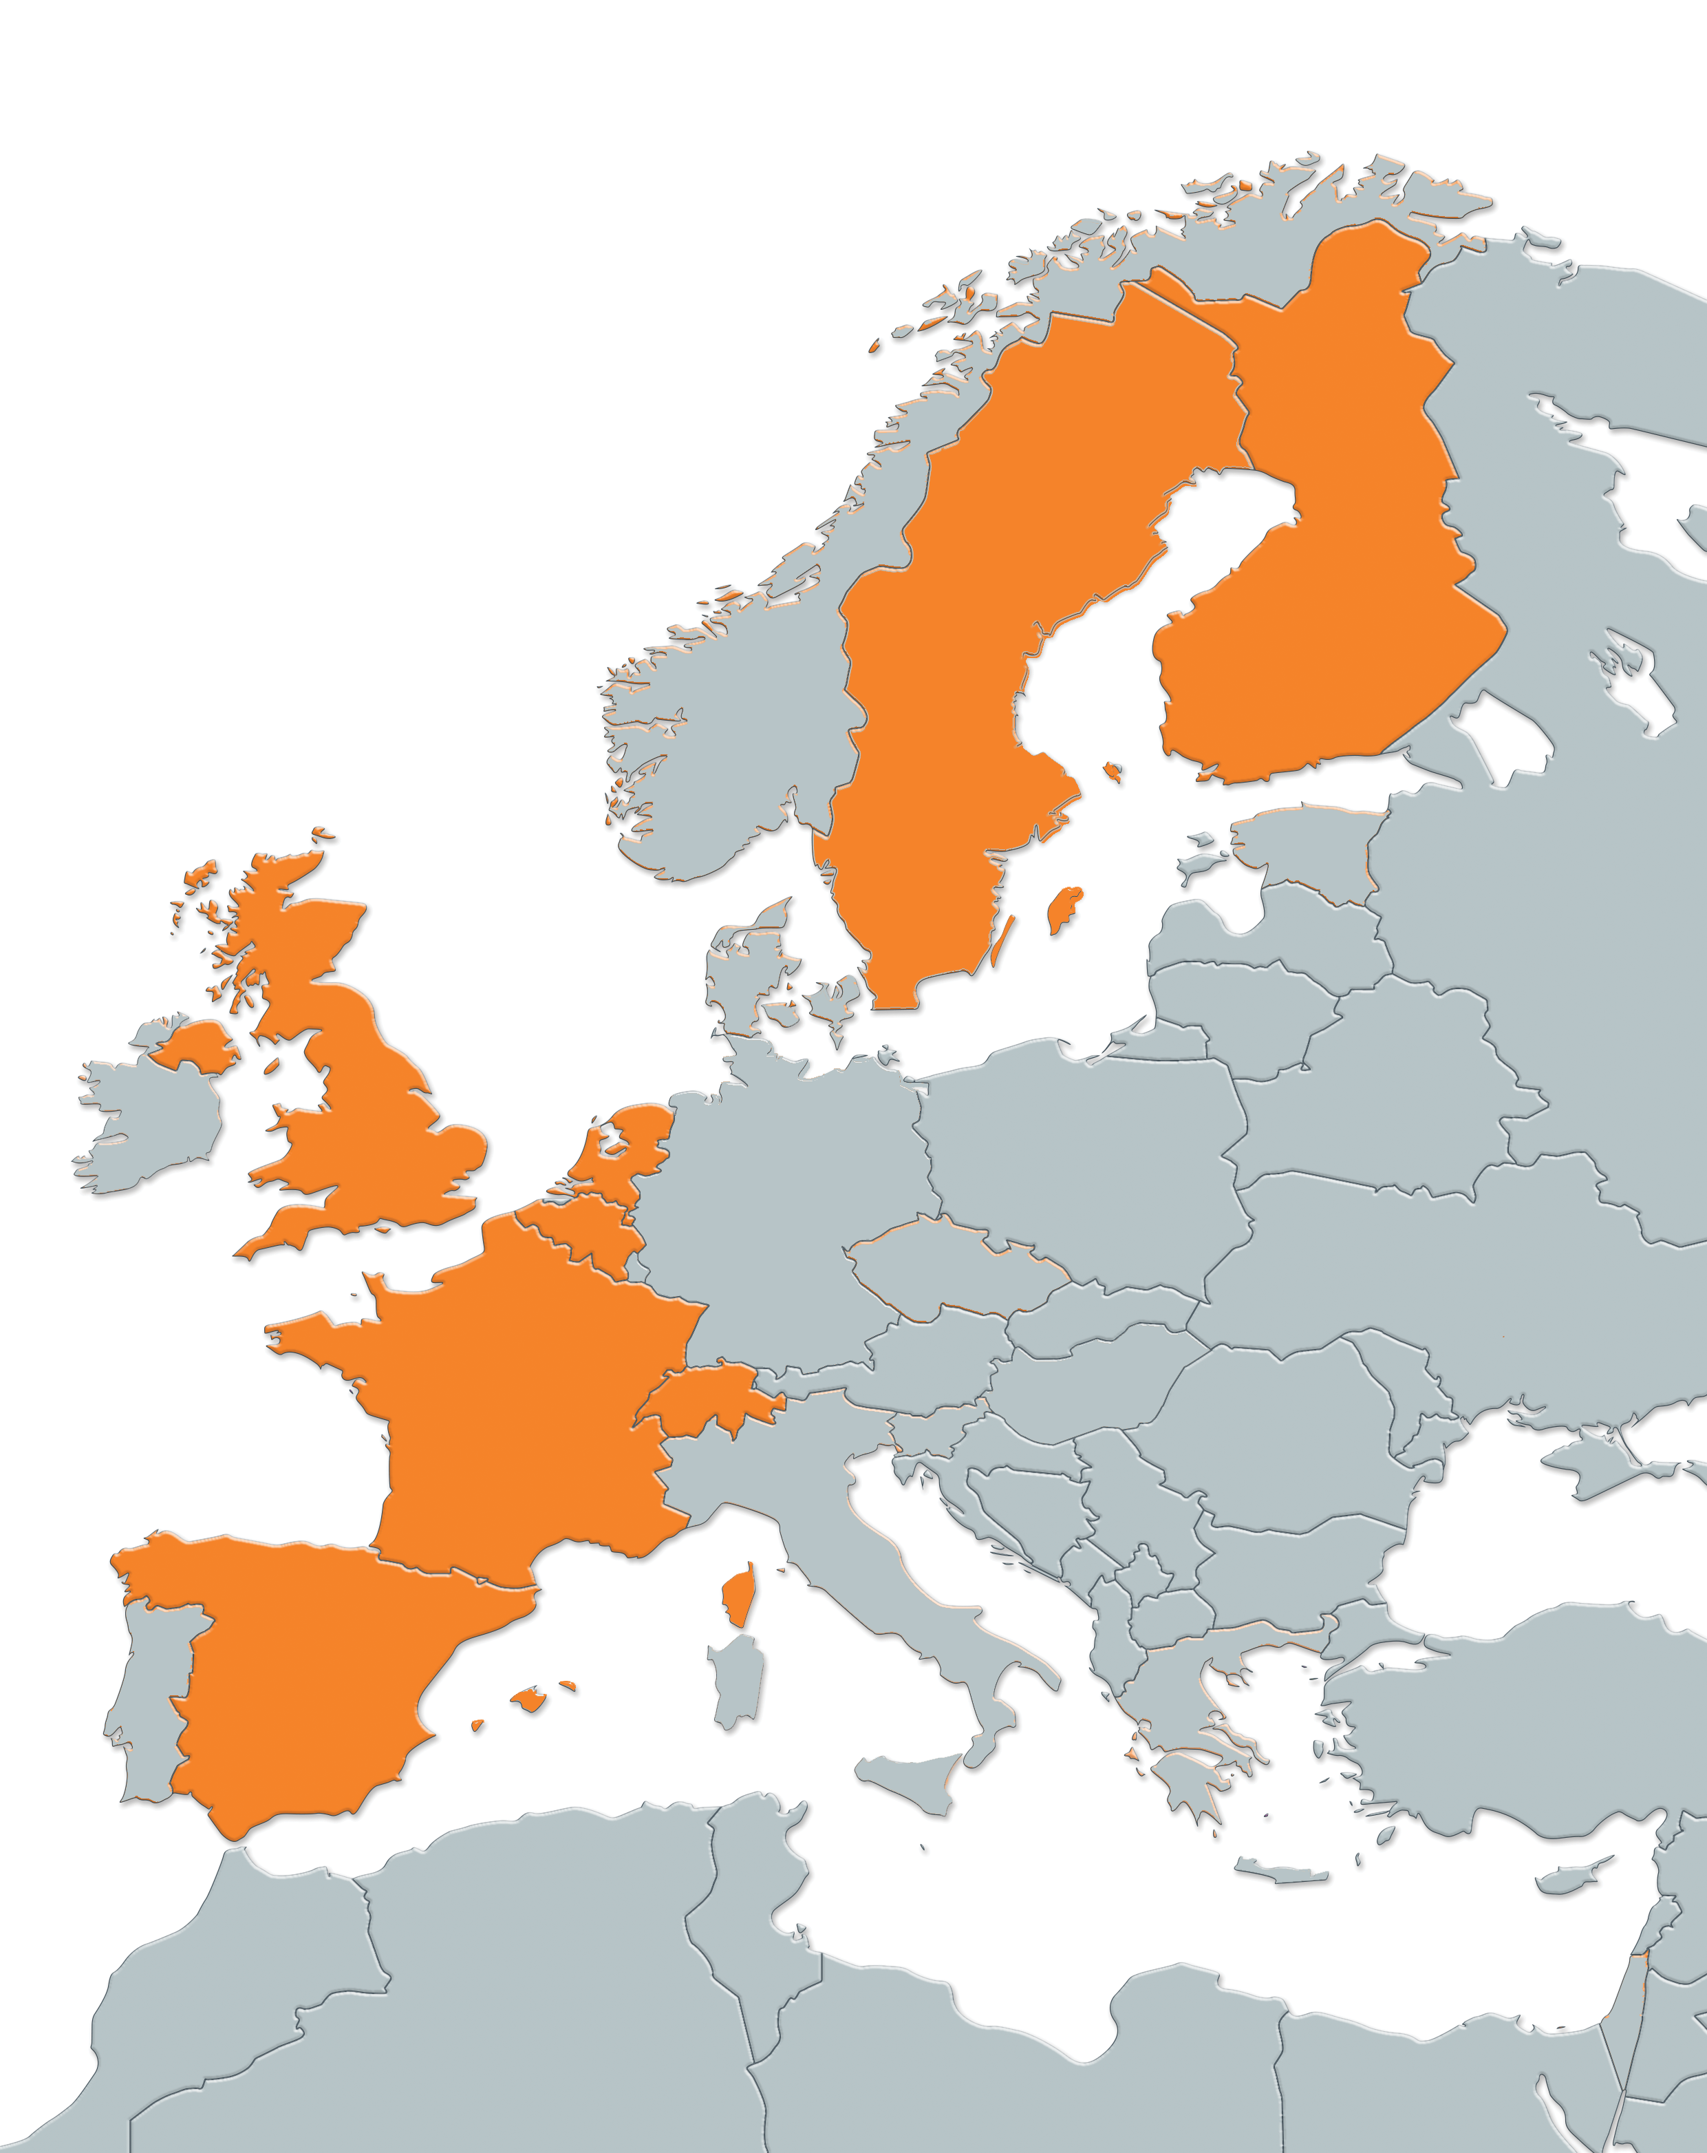






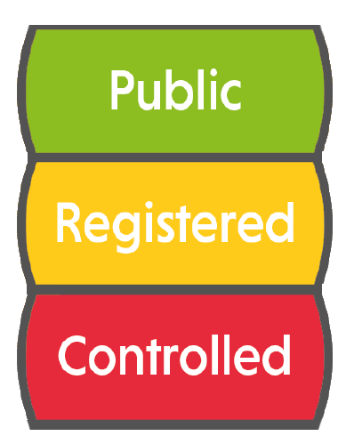


ELIXIR and Beacons
Funding to drive implementation of the Beacon technology within ELIXIR nodes
ELIXIR Authentication and Authorization Infrastructure
Accessible to internet users
Accessible to bona fide researchers
Authorized – signed agreement needed
Press release: https://www.elixir-europe.org/news/elixir-beacons-facilitate-sharing-genomics-data-europe
www.elixir-europe.org/beacons

Slide 5
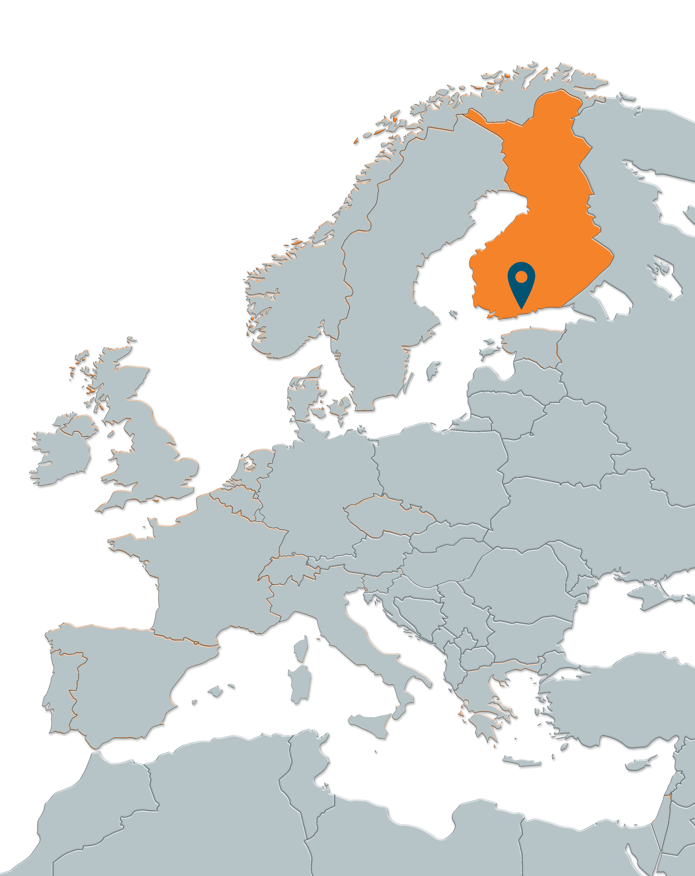
ELIXIR Finland
http://elixir-beacon.csc.fi
105 samples from International Genome Sample Resource*
WGS
1st beacon connected to the ELIXIR AAI:
releases national allele frequencies publicly
provides registered access to the aggregated information from the cohorts used for defining the national allele frequencies during 2017
http://www.internationalgenome.org/data-portal/population/FIN from the 1000genomes project: 1000Genomes Finns

Slide 7
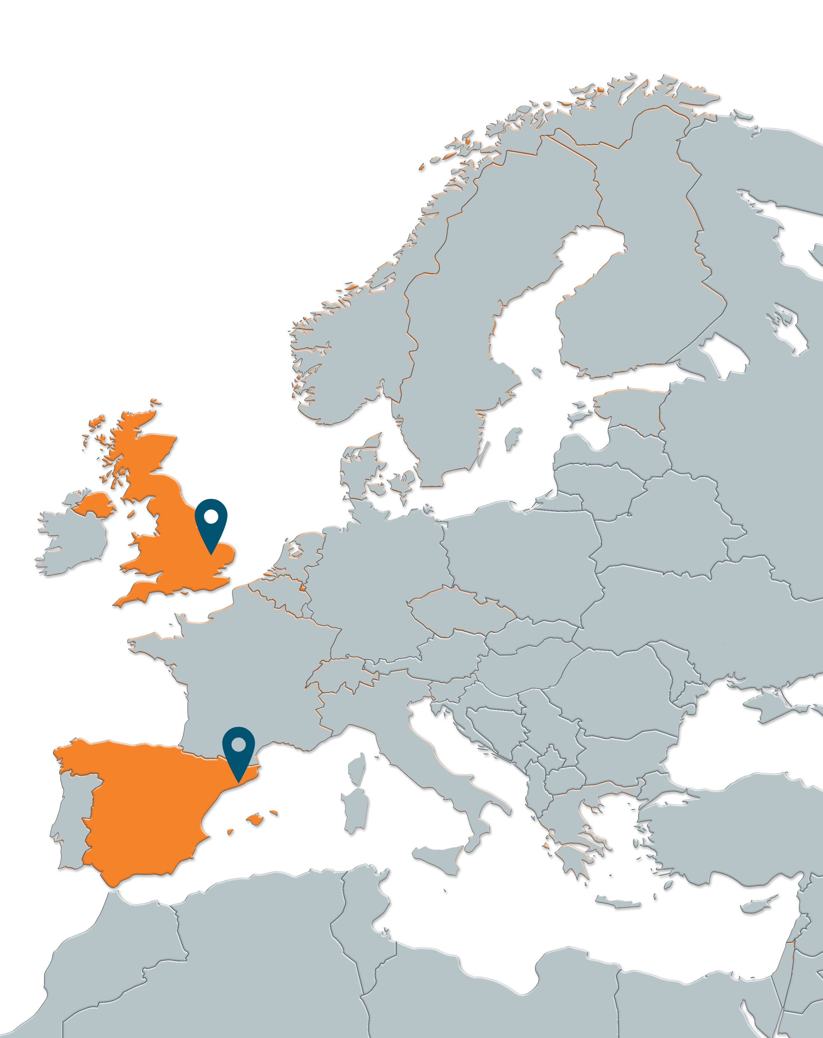
European Genome-phenome Archive
https://ega-archive.org/beacon/#/
36,963 samples included in 22 different datasets
GWAS (22 datasets), exome sequencing (18 datasets)
Data from: UK10K study (TwinsUK, ALSPAC), LifeLines cohort and other studies
Collaboration between EMBL-EBI and Center for Genome Regulation, ELIXIR Spain

Slide 8
ELIXIR Beacon project 2017
More European data discoverable
New features e.g.
ELIXIR Beacon Network
Monitoring and security to identify re-identification attempts

Slide 9
Beacons as a use case for bioschemas
ELIXIR will be developing a beacon network (registry and search engine) and is considering development of the Beacon project into a service
Problem
Registration of a Beacon service in the ELIXIR Beacon Network will be done manually
Updates will be manual if the beacon service changes
Objectives
Expose Beacon service metadata in its default landing web page with Bioschemas
Automate the ingestion of the beacon service metadata into the Beacon Network

Slide 10
Thank you!
Audald Lloret-Villas (EGA-CRG)
audald.lloret@crg.eu

